Slide 1
Used Bike Prices – Feature Engineering and EDA
Presented by: Ashok Nagar
Tools: Python, Pandas, Seaborn, Matplotlib

Slide 2
Problem Description
- Used bike prices vary significantly based on brand, age, mileage, and condition.
- The goal is to identify key factors that influence the resale price.
- Use feature engineering and EDA to clean data, derive new insights, and prepare it for modeling.

Slide 3
Feature Engineering
- Created 'age' = 2023 - year
- Converted text fields to numeric
- Removed rows with zero or unrealistic values

Slide 4
Exploratory Data Analysis
- Visualized distributions of price, power, engine size, and mileage
- Identified outliers and skewed distributions
- Placeholder for graphs (Histogram, Boxplot, Heatmap)

Slide 5
Key Insights
- Power and engine size have strong positive correlation with price
- First-owner bikes command higher prices
- Age negatively impacts price
- Mileage has a weak negative correlation

Slide 6
Conclusion
- Feature engineering improved data quality
- EDA helped discover important patterns and relationships
- Dataset is now ready for predictive modeling

Slide 7
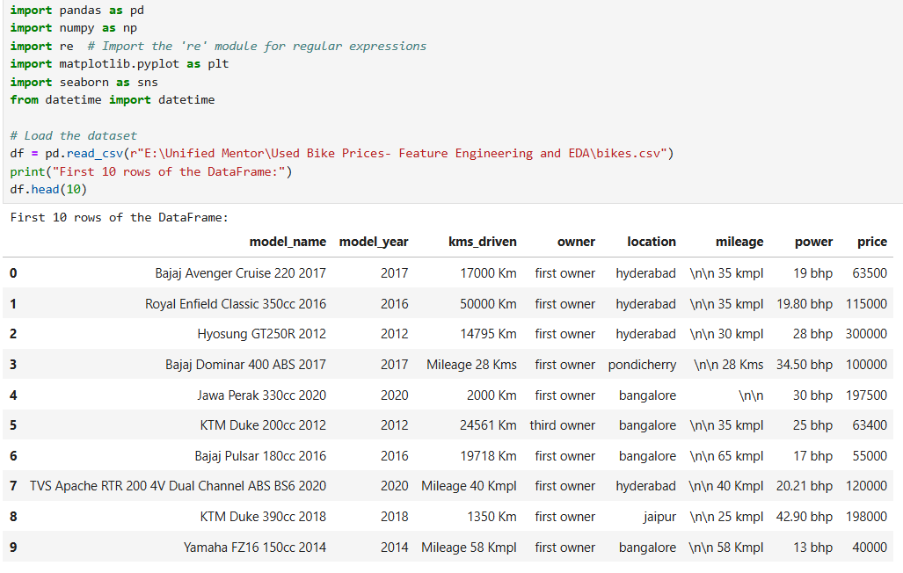
Python Code
Step 1: Data Collection - Load and inspect the dataset

Slide 8
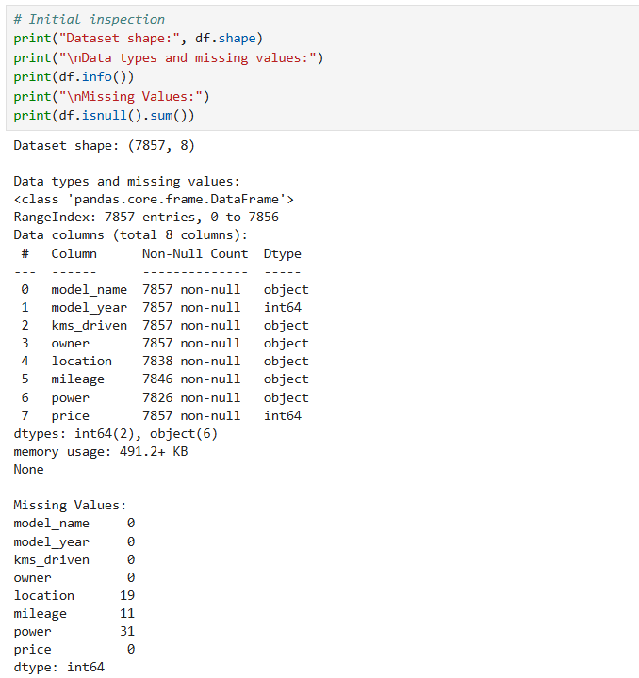
Step 2: Data Preprocessing

Slide 9
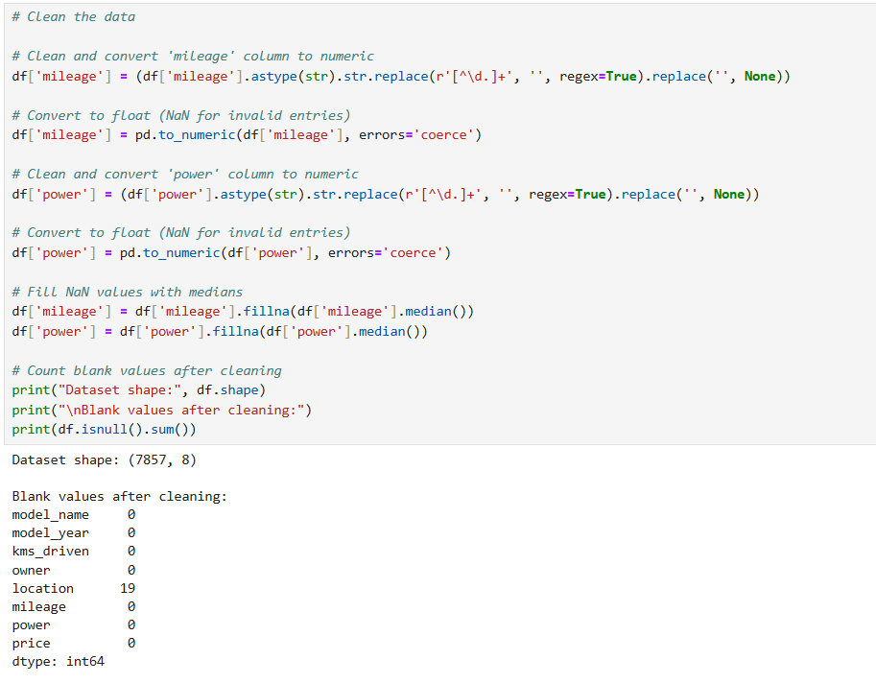

Slide 10
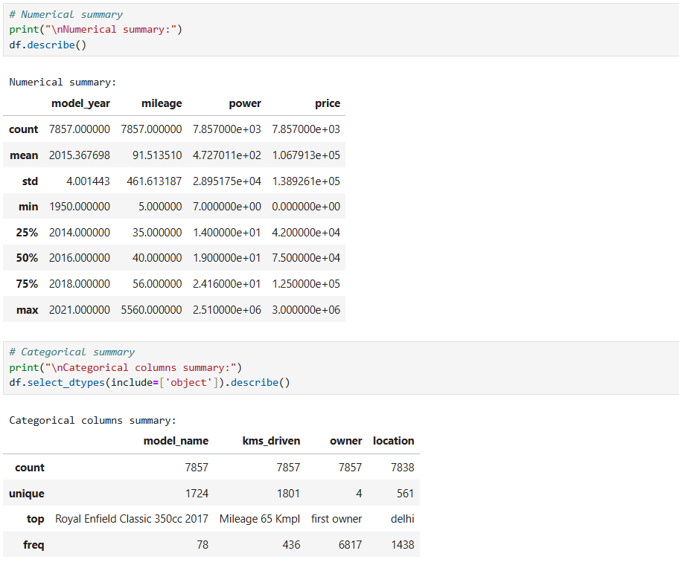
Step 3: Exploratory Data Analysis (EDA)

Slide 11
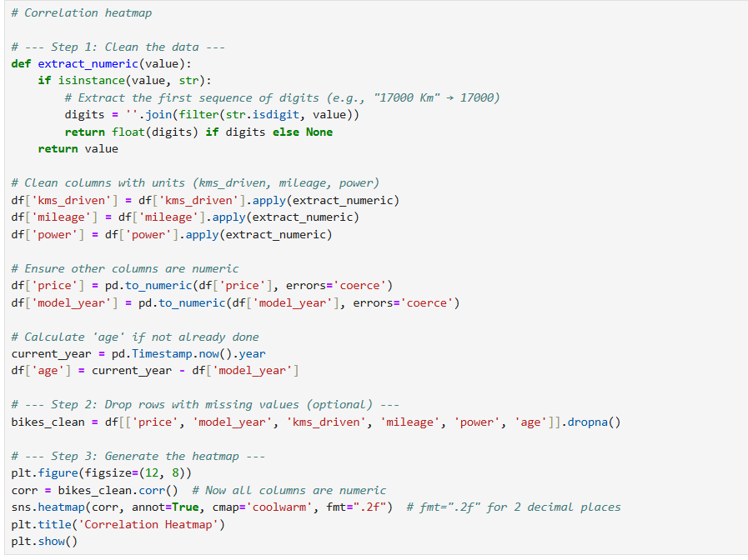
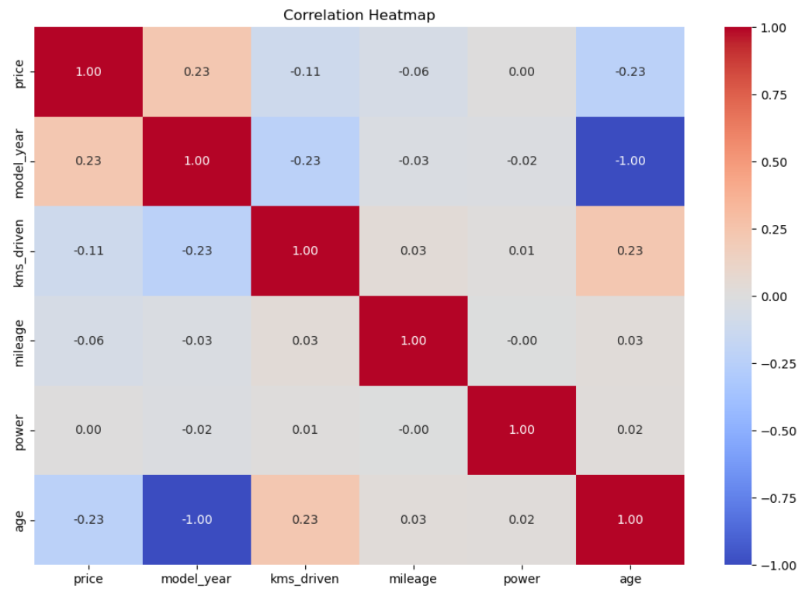

Slide 12
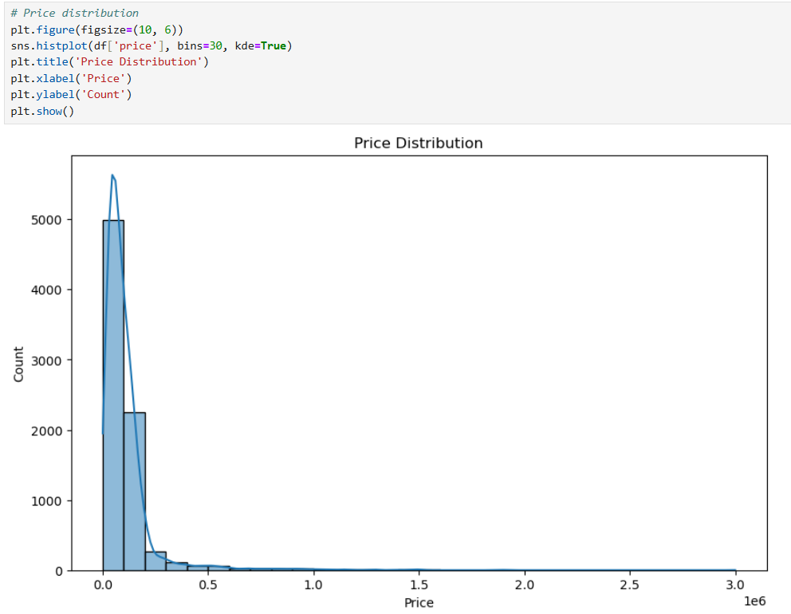
Step 4: Visualization

Slide 13
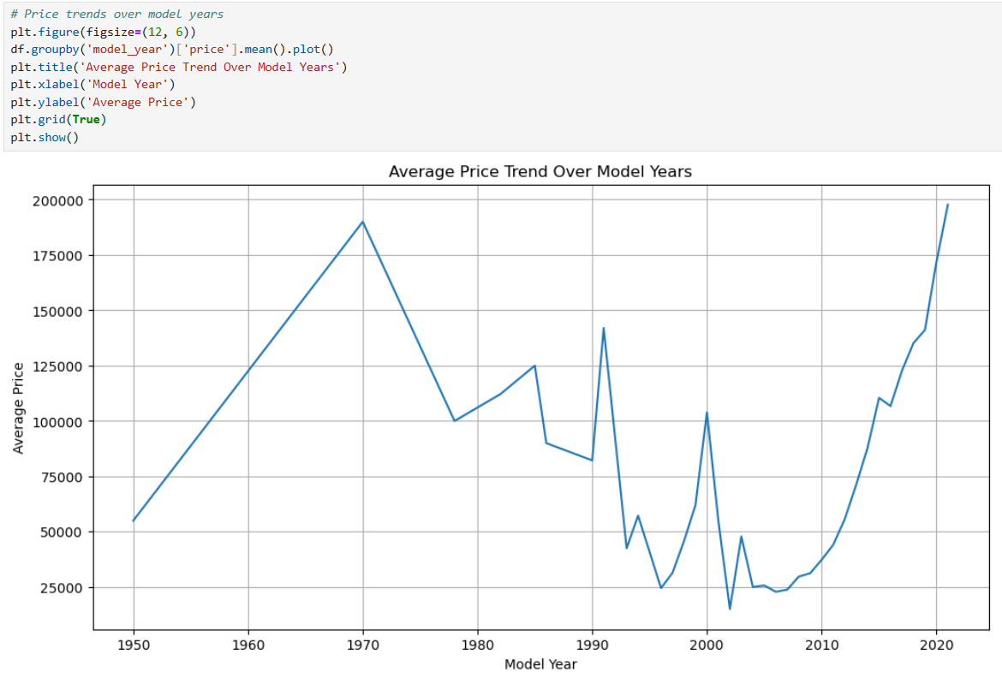

Slide 14
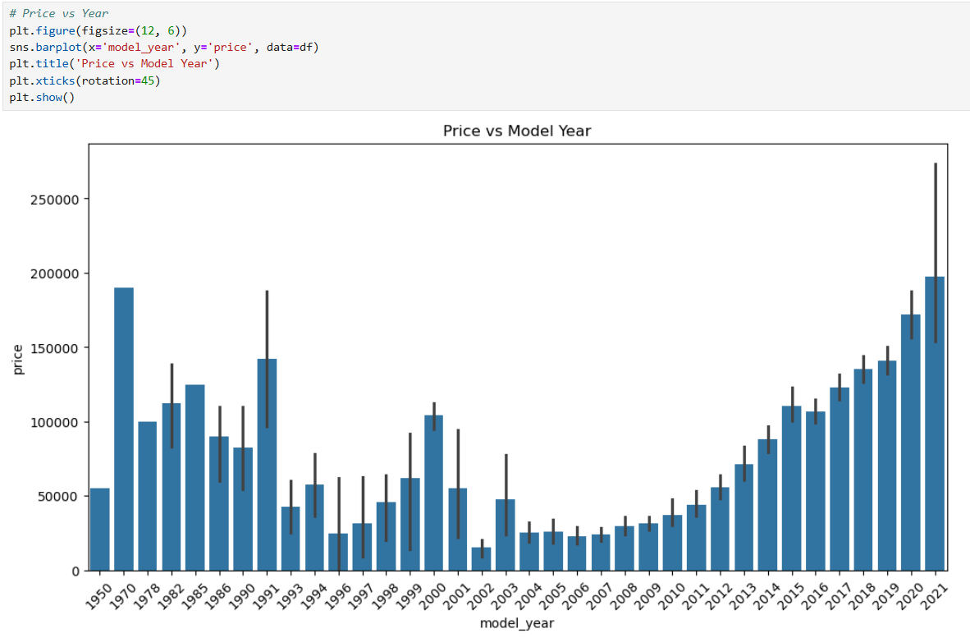

Slide 15
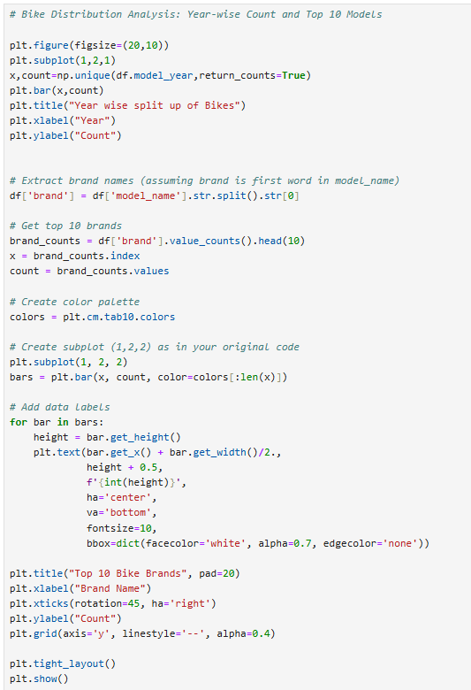
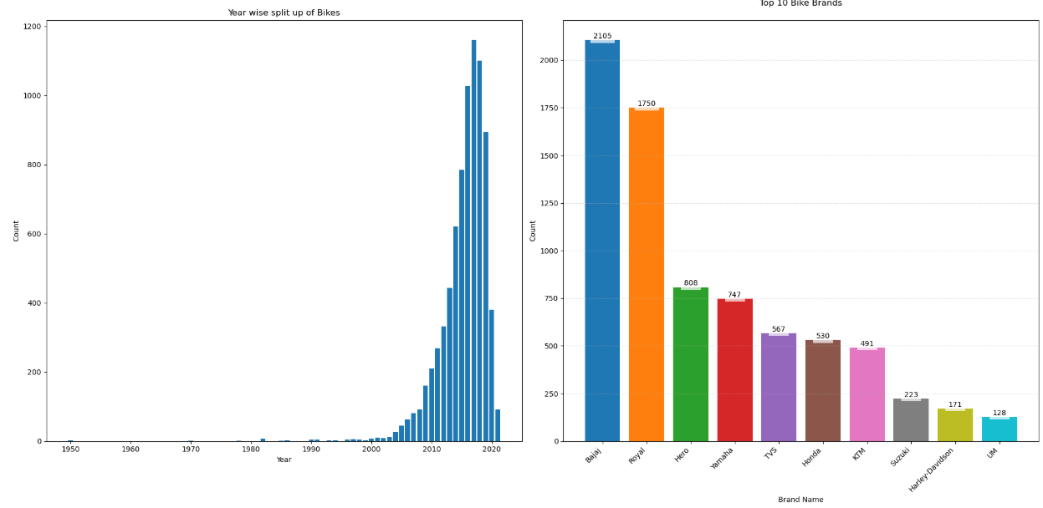

Slide 16
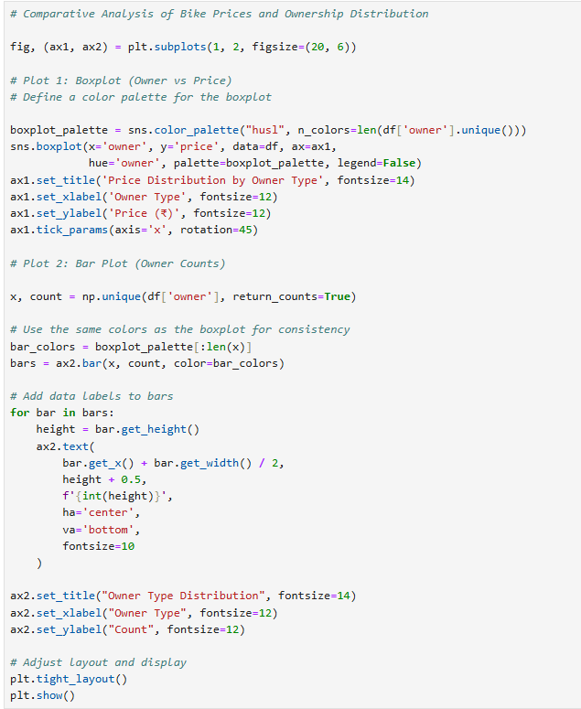
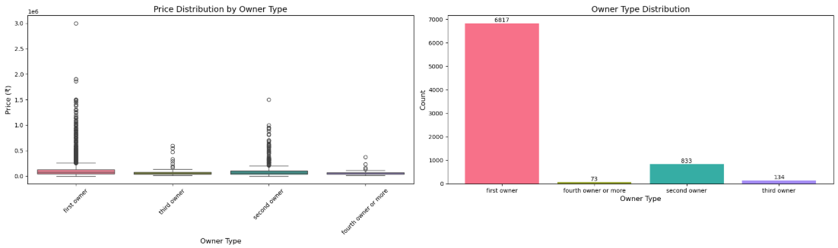

Slide 17
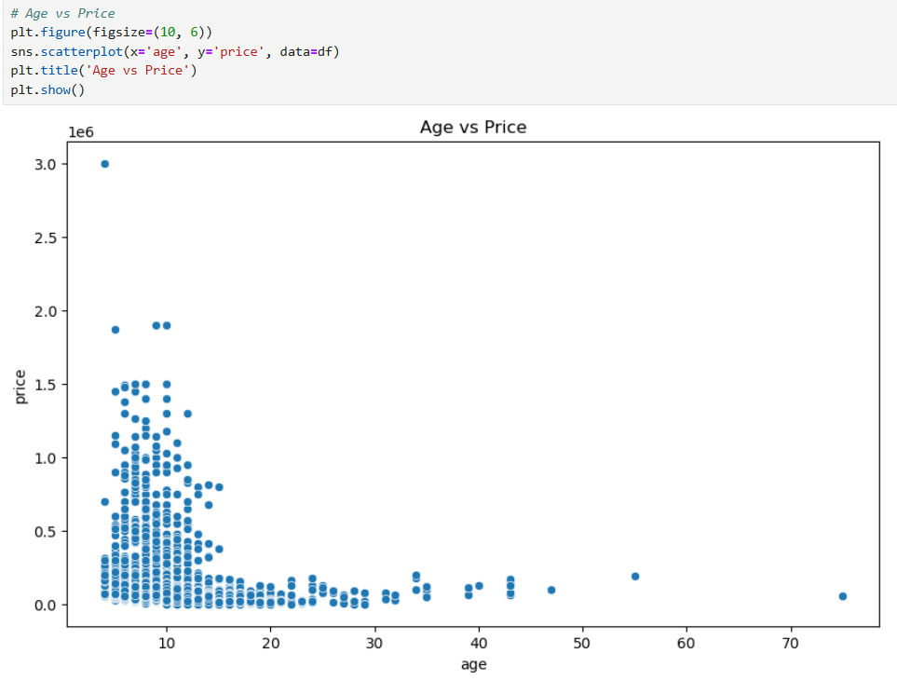

Slide 18
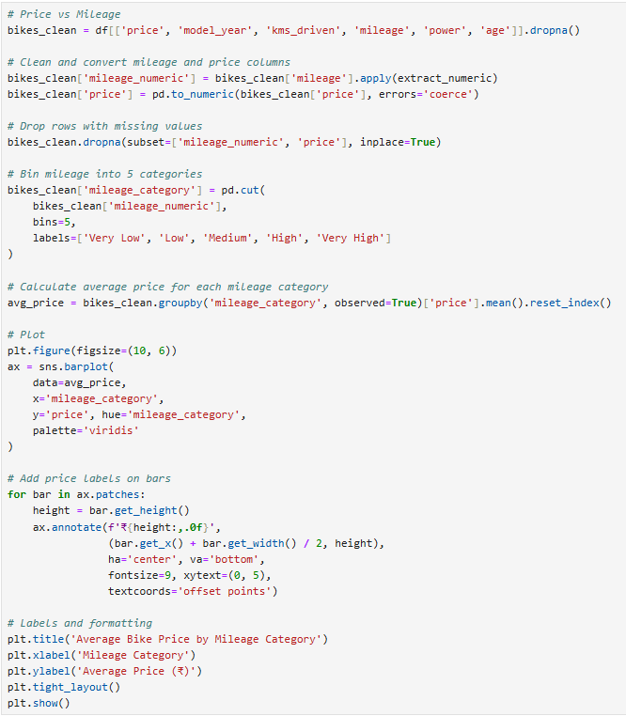
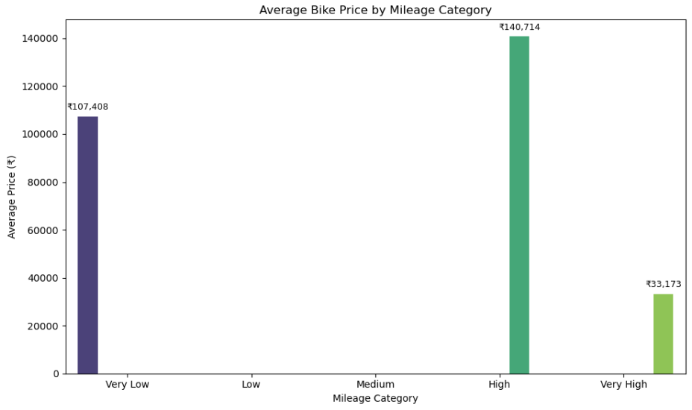

Slide 19
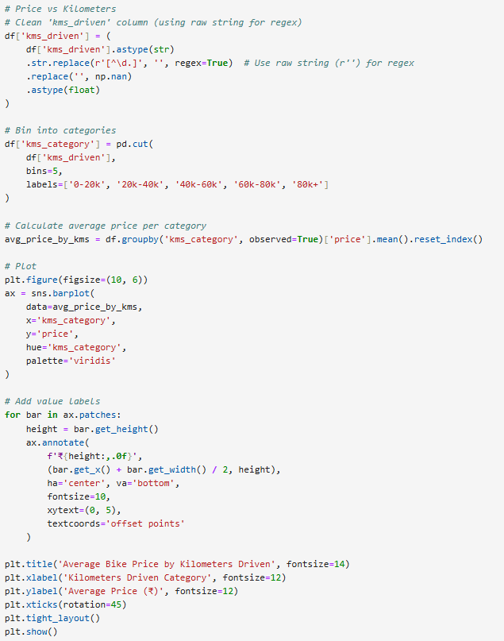
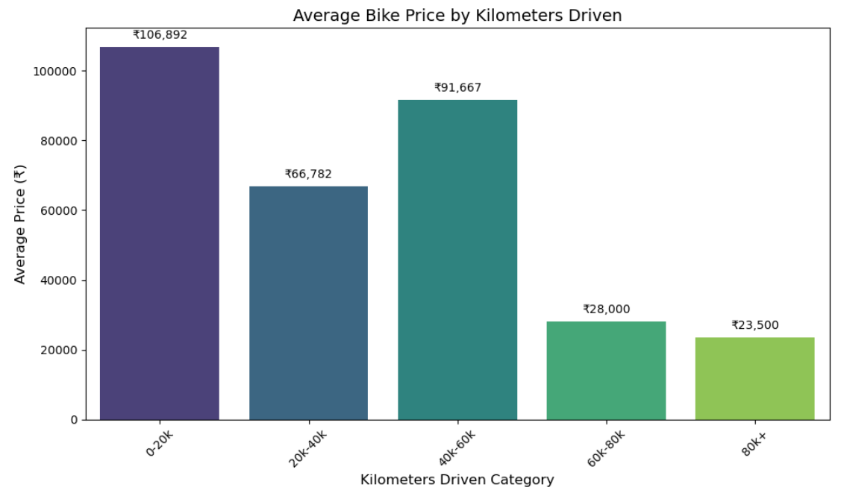

Slide 20
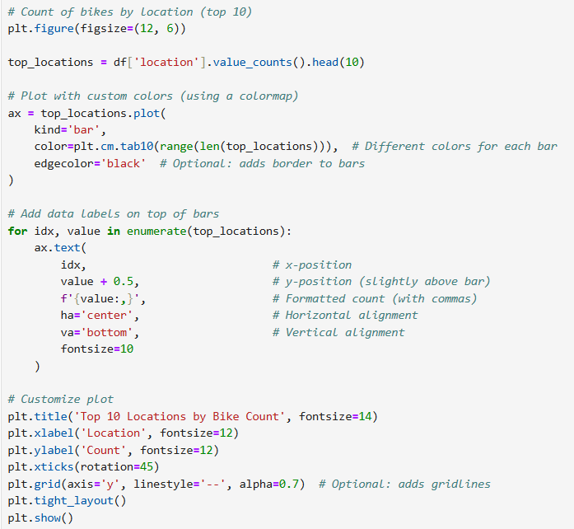
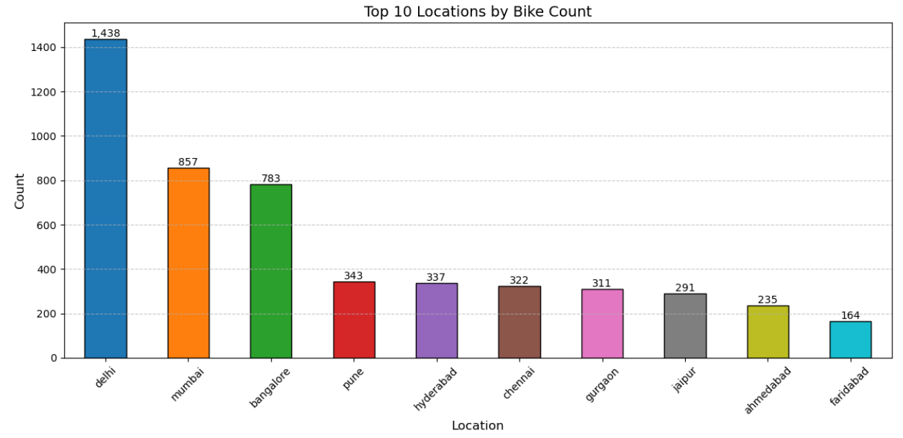

Slide 21
